Slide 1

OmniVista
Training App
TMA OmniVista 2500 Core Team

Slide 2
Overview
This training exercise is for new developers to get familiar with Java/Web technologies used in OmniVista Development project.
Candidates are required to implement a web application to:
  Manage network devices (e.g. Switches, Routers…)
  Provide real-time alarms
  Deal with chart, tree, table… components to show statistics data
  All management functions are provided to users via Web UI
Candidates also need to provide Unit tests with Jasmine framework

Slide 3
Architecture
Server
Client
JVM 1.7
HTML5
Server-sent-event
AngularJS
HTML5
CSS3
Tomcat 7
Spring 3
NMS
Restful
web-service
Hibernate 3
JDBC
MySQL

Slide 4
Server Side
Technologies used:
Spring 3
  Dependency Injection
  Hibernate Integration
Jersey 2.0 as REST service provider
MySQL to store data
Hibernate 3
  Generate the schema
  Object Relational Mapping
  Data Access Objects
  Transaction manager

Slide 5
Server Side (cont)
Source Code Directory Structure:
nms-api
Provide value objects that are used for communicating between client and server
Main module of the NMS app, provide::
Spring Services
JAX-RS provider
Event Handling
Converter : convert model to api and vice versa
DAO
nms-app
nms-data
Provide the data, entities for whole app

Slide 6
Client
Technologies used:
AngularJS as MVC Framework.
ng-table for table widget.
dynatree for tree widget.
D3 for chart widget.
Listen to server updates with HTML5 server-sent-event.
Localization support.

Slide 7
Client (cont)
Source Code Directory Structure:
  /webapp contains the client code.
  /css contains styling files.
  /i18n contains localiaztion strings for the app.
  /js contains all the javascript code based on AngularJS
  /lib contains all 3rd party js libraries
  /partials contains other UI fragments (add / detail / edit / list)
  /WEB-INF contains server configuration files.
  Index.html is the master page.

Slide 8
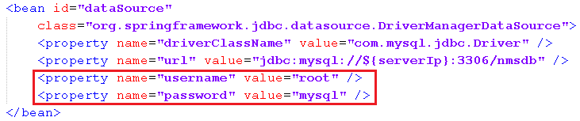
How to run the demo
Create database with name “nmsdb” and import data from ../data/db.sql
Update the ApplicationContext (.. src\main\resources\META-INF) with your local database information
Build the demo project using Maven 3.x
Deploy to Tomcat server

